Slide 1
Derived Relational Responding and Horse Track Betting
Seth W. Whiting
Mark R. Dixon

Slide 2
Gambling
The National Council of Problem Gambling suggested that upwards of 80 percent of American residents have gambled once or more in their life (2011).
Further, approximately 2.3 percent of the general population engage in problem gambling (Kessler et al., 2008).

Slide 3
Horse Racing
Consumer spent approximately $6.4 billion at racetrack casinos in 2009
This reflects an increase of 5% since 2008
As of 2010, there are 44 racetrack casinos throughout 12 states
(American Gaming Association)
(Dunstan, 1997)
Casino Games
Racetrack Facilities

Slide 4
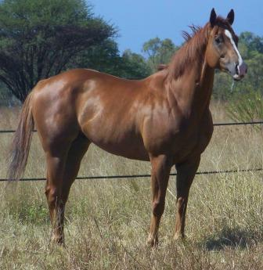
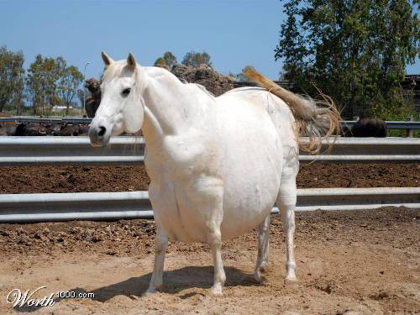
Influences on Horse Gambling
Choices based on formal properties
Would you gamble on…
Horse 1
Horse 2

Slide 5
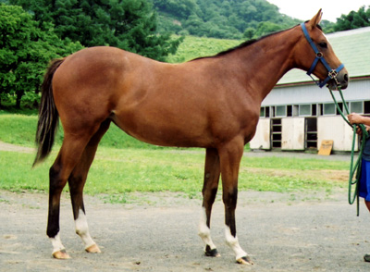
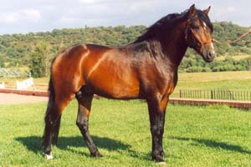
Horses at the Kentucky Derby…
All look similar
Other features: names, colors, jockey colors

Slide 6
Transformation of Function
Transformation: in the absence of direct training, a stimulus can acquire a function through inclusion in a stimulus class or relation(Dougher, Perkins, Greenway, Koons, & Chiasson, 2002)
Rehfeldt & Hayes (1998) examined this phenomenon with untrained temporal differentiation

Slide 7
Rehfeldt & Hayes (1998)
Participants responded on a
conjunc FR5 t ı < IRT < t₂ reinforcement schedule
Stimuli were placed in a class via conditional discrimination training
Participants clicked on novel stimuli with the same temporal responses, despite the lack of training
Responding can come under discriminative temporal control via transformation of function

Slide 8
Dixon, Wilson, & Whiting (in press)
Extended these findings to a horse track gambling context
Participants were trained to respond to stimuli on conjunc FR5 t ı < IRT < t₂ reinforcement schedule
When placed in an equivalence class with a colored square, participants increased bet allocation to horse of the color requiring clicking on the lowest IRT
No direct training

Slide 9
Dixon, Wilson, & Whiting (in press)
However, betting was between 8 colored horses, and only 3 were included in conditional discrimination training
Resulting in inconsistent changes
and some increases on “medium” and “slow” horse
Mastery on equivalence test was not required
Participants were inexperienced gamblers (SOGS 0-2)

Slide 10
Current Study
Seek to extend the previous studies by…
Examining the transformation of function on a simulated horse track
Using Problem/Pathological gamblers as participants
Controlled betting- 2 horses only
Require demonstration of equivalence relation

Slide 11
Participants and Setting
Participants included 3 undergraduate students from Southern Illinois University
Procedures completed on campus in a lab setting on a desktop computer
Simulated horse track was created using Microsoft Visual Studio 2008

Slide 12
Participants
Average age: 20.67 (20-21)
All Male, income <5000, single, no children
Mean SOGS score: 4.67 (4-6)

Slide 13
Horse Track Pre-Test
Participants bet up to 10 hypothetical credits per trial
This phase lasted for 10-30 trials, randomly selected by computer
Nonconcurrent multiple baseline
Random outcomes

Slide 14
Video of horse race
Notes:
Orange and purple horses were each programmed to win for sure on 30% of trials
70% of trials had random outcome
All horses speed up or slow down several times
1/8 chance to win- all horses pay 8X bet

Slide 15
Pretraining
One of two random stimuli was presented. Participants had to respond on an FR-5 schedule to earn reinforcement across 15 trials.
Stimuli were not used at any other time

Slide 16
Conjunc FR 5 t1 < IRT < t2 Training and Testing
Conjunc FR 5 0.0 < IRT < 0.5
Conjunc FR 5 1.5 < IRT < 3.0
A1
A3

Slide 17
Conjunc FR 5 t1 < IRT < t2 Training and Testing
Participants were required to click on A1 and A3 stimuli for 15 successful trials each.
The stimuli were then presented randomly for 16 trials to test the trained functions.
13/16 to pass

Slide 18
Match-to-Sample
A-B and B-C relations were trained individually and mixed.
Reflexivity A-A B-B C-C
Symmetry B-A C-B
Transitivity A-C
Equivalence C-A

Slide 19
Stimuli
 | 1 | 2 | 3
A
B | RIW | DAX | QAF
C

Slide 20
A-B
B-C
Mixed A-B, B-C
Refl. A-A, B-B, C-C
Sym. B-A, C-B
Trans. A-C
Equiv. C-A
Criterion: 16/18
Feedback: Yes

Slide 21
A-B
B-C
Mixed A-B, B-C
Refl. A-A, B-B, C-C
Sym. B-A, C-B
Trans. A-C
Equiv. C-A
Criterion: 16/18
Feedback: Yes

Slide 22
A-B
B-C
Mixed A-B, B-C
Refl. A-A, B-B, C-C
Sym. B-A, C-B
Trans. A-C
Equiv. C-A
Criterion: 32/36
Feedback: Yes

Slide 23
A-B
B-C
Mixed A-B, B-C
Refl. A-A, B-B, C-C
Sym. B-A, C-B
Trans. A-C
Equiv. C-A
Criterion: none
Feedback: no

Slide 24
A-B
B-C
Mixed A-B, B-C
Refl. A-A, B-B, C-C
Sym. B-A, C-B
Trans. A-C
Equiv. C-A
Criterion: none
Feedback: no

Slide 25
A-B
B-C
Mixed A-B, B-C
Refl. A-A, B-B, C-C
Sym. B-A, C-B
Trans. A-C
Equiv. C-A
Criterion: none
Feedback: no

Slide 26
A-B
B-C
Mixed A-B, B-C
Refl. A-A, B-B, C-C
Sym. B-A, C-B
Trans. A-C
Equiv. C-A
Criterion: 15/18
Feedback: No
If failed: back to Mixed

Slide 27
Horse Track Post-Test
Betting was again measured over 31-60 trials on the horse track
Number of trials was again selected at random

Slide 28
Results
 |  | Discrimination Training |  |  | Discrimination Testing
Participant | Temporal Testing (trial blocks to criterion) | A-B Training (trial blocks to criterion) | B-C Training (trial blocks to criterion) | Mixed A-B/B-C Training (trial blocks to criterion) | Reflexivity (%) | Symmetry (%) | Transitivity (%) | Equivalence (%)
1 | 1 | 1 | 2 | 1 | 100 | 100 | 100 | 100
2 | 2 | 2 | 2 | 1 | 100 | 100 | 88.9 | 100
3 | 2 | 6 | 14 | 2 | 100 | 100 | 100 | 100
*Participant 2 failed equivalence testing once, participant 3 failed twice.
Testing scores reflect the percent correct when criterion was met

Slide 29
Results
All participants passed temporal testing in 1-2 trial blocks
Participants 2 and 3 failed equivalence testing, but finished with 100% accuracy when they met criterion

Slide 30
Avg. bet per 5 race trial Block

Slide 31
Betting Summary
+8.46%
+0.93%
+17.66%

Slide 32
Betting Results
All participants increased betting on the “fast” horse
Participant 2 changed bets minimally
Reported that the odds were likely even

Slide 33
Discussion
Results were consistent
Change maintained throughout all trials following training
Scores on equivalence test showed the presence of established equivalence classes and derived relations
Post-training gambling allocation suggests that the color of the horse with formal similarity to the C stimuli in relational training acquired the function of “faster than”

Slide 34
Discussion
Arbitrary stimuli acquired functions through differential reinforcement, and those functions transformed to other stimuli placed in the same class
The results provide evidence that verbal behavior plays an important role in gambling
The word “faster” or “slower” were never mentioned, functions were acquired through clicking rate only

